Slide 1

Multimedia Data Management
Lecture 11 – Security & Maintainance
Fall 2022

Slide 2
Should our clients be able to see the whole material of our web application without being logged in?
Notes:
Furthermore, how should them see it after logging in?
In University big example, the students cannot see other students’ marks for instance.

Slide 3
Security
Security is a one of the main topics to focus on when developing almost any program.
For web application, security measurements should be persistent in deployment, front-end, back-end, and the database.
In this lecture we only focus on a part of back-end security tools provided by Django.

Slide 4
Django Auth
The auth system consists of:
Users
Permissions: Binary (yes/no) flags designating whether a user may perform a certain task.
Groups: A generic way of applying labels and permissions to more than one user.
A configurable password hashing system
Forms and view tools for logging in users, or restricting content
A pluggable backend system
Notes:
Django comes with a user authentication system. It handles user accounts, groups, permissions and cookie-based user sessions.

Slide 5
User Class
User objects are the core of the authentication system.
Only one class of user exists in Django’s authentication framework, i.e., 'superusers' or admin 'staff' users are just user objects with special attributes set, not different classes of user objects.
Notes:
The primary attributes of the default user are:
username
password
email
first_name
last_name

Slide 6
Login Requirement
We can restrict the functionalities of our Django project to login requirement.
The proper place to set up login requirement is views.py
Django has two mechanisms to ensure login requirement. For function-based views, we should use a decorator to extend the function. And for class-based views we should use inheritance.

Slide 7
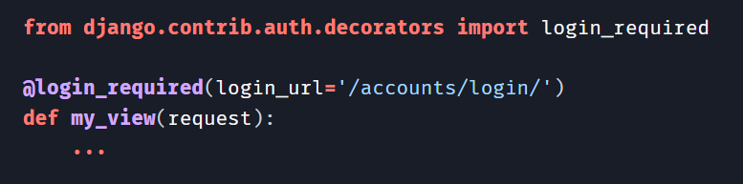
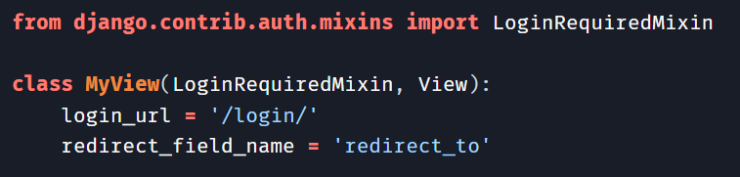
Login Requirement
Using the Django authentication system | Django documentation

Slide 8
Is it efficient to validate our web applications manually?
Notes:
We have some automated testing frameworks used to validate web applications across different browsers and platforms.
We should run automated tests to check the functionalities of our web project, add/remove features and even improve our UI/UX

Slide 9
Django Tests
Automated testing is an extremely useful bug-killing tool for the modern web developer. You can use a collection of tests to solve, or avoid problems such as:
When you’re writing new code, you can use tests to validate your code works as expected.
When you’re refactoring or modifying old code, you can use tests to ensure your changes haven’t affected your application’s behavior unexpectedly.
Notes:
We define our unit testing in tests.py by default but you can make it more explicit by defining test_models.py, test_views.py etc.

Slide 10
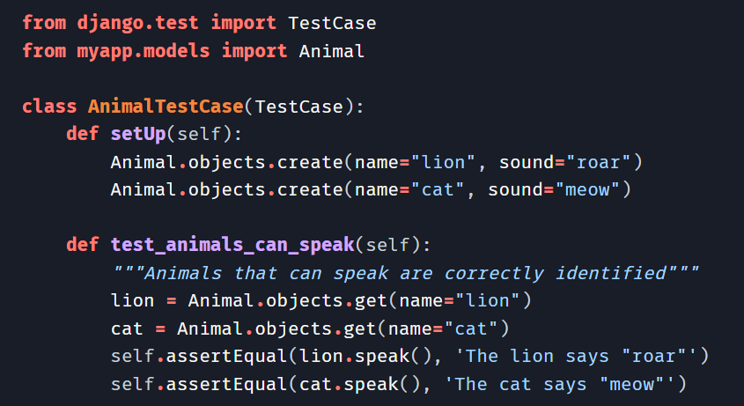

Django Tests
Testing in Django | Django documentation
Notes:
There are several ways to run your tests available on the documentation

